Slide 1
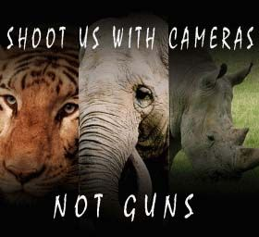
Save animals
Wildlife week 09-10-17 to 12-10-17

Slide 2
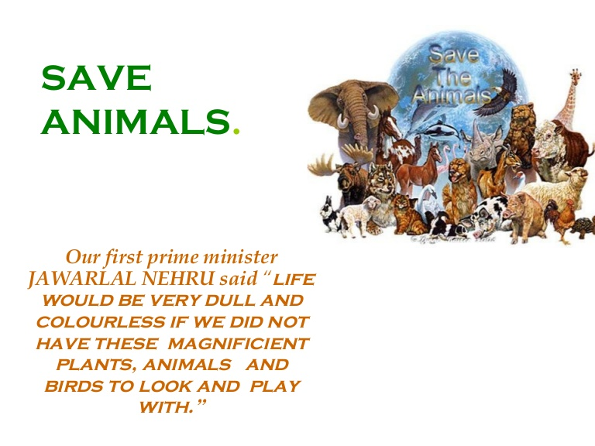

Slide 3
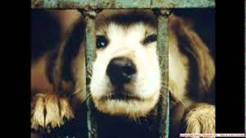
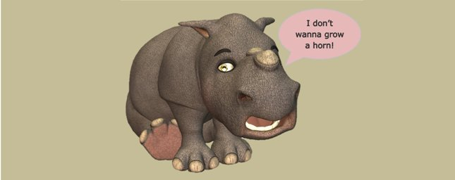
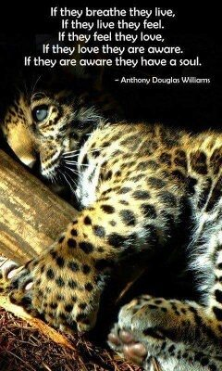
Have a look at these pictures . Do you find anything wrong in them?

Slide 4
IMPORTANCE OF ANIMALS
Animals are an IMPORTANT PART OF MOTHER NATURE
They have equal right to live as humans have. But few people kill animals for ENTERTAINMENT PURPOSES and to FULFILL THEIR NEEDS.
Killing of animals leads to the decrease in the number of animals.
It is also a CRIME against the law of nature.

Slide 5
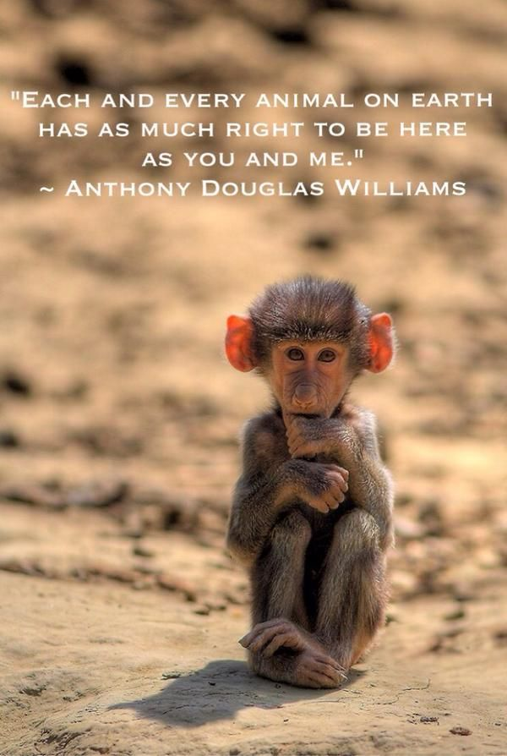
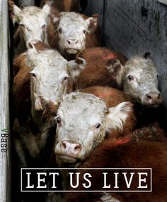

Slide 6
WHY DO PEOPLE KILL ANIMALS ????
To eat them – Animals like hens, cows, dogs, pigs, buffaloes,fishes etc are killed for their flesh. People who are non vegetarians kill such animals and eat them.
For their skin – Animals like leopard, polar bear etc are killed for their skin which is used to make clothes,

Slide 7
For cosmetics and scents – Musk deer is killed for its glands which secrete musk used in making perfumes.
To get jwellery – Ivory which is used in making ornaments is obtained by killing elephants.
For entertainment – Hunting is a practice that has been followed since ages . People used to hunt for fun.

Slide 8
REMEMBER!!
We should not kill or harm animals for our own selfish needs . Animals also have feelings and we should respect them. They have equal right to live as we have.

Slide 9
You must have learnt about the ways people harm animals..
But
Now the question arises
??????????

Slide 10
HOW CAN WE SAVE ANIMALS FROM THIS CRUELTY AND EXTINCTION?
CAN YOU AND I DO ANYTHING?

Slide 11
THE ANSWER IS DEFINITELY
YES…… WE CAN

Slide 12
Do not harm animals. Also stop others from doing so.
Provide shelter and food to them if you can
Inform PETA if you see any animal in danger.
Do not disturb animals by putting crackers on them.
LOVE THEM

Slide 13
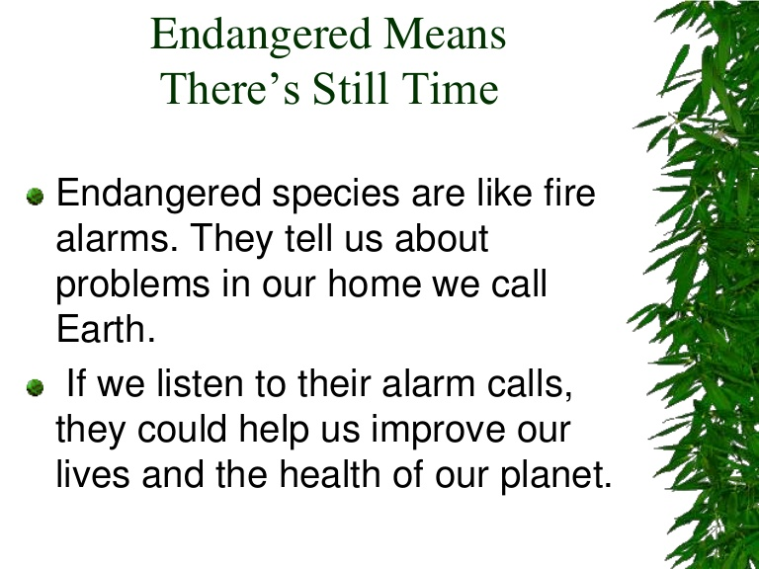
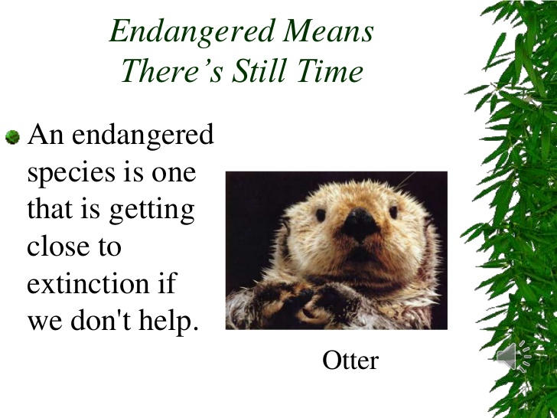
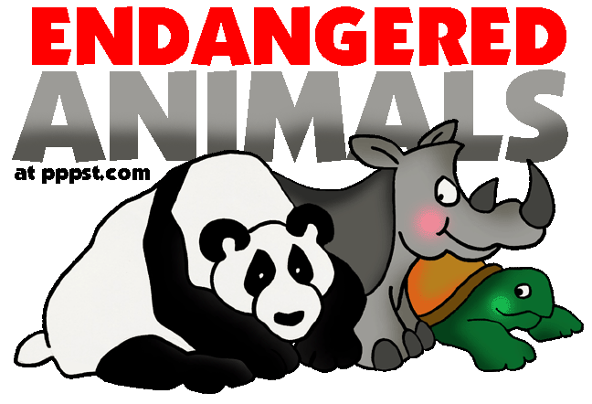
ENDANGERED SPECIES

Slide 14
LET US KNOW WHAT ARE ENDANGERED SPECIES

Slide 15
Endangered Species
Endangered species are those species which are no more present on Earth because of a sudden decrease in their number.
It is caused because of any natural factor like eartquake, volcano or by man activities like poaching and killing of animals.

Slide 16
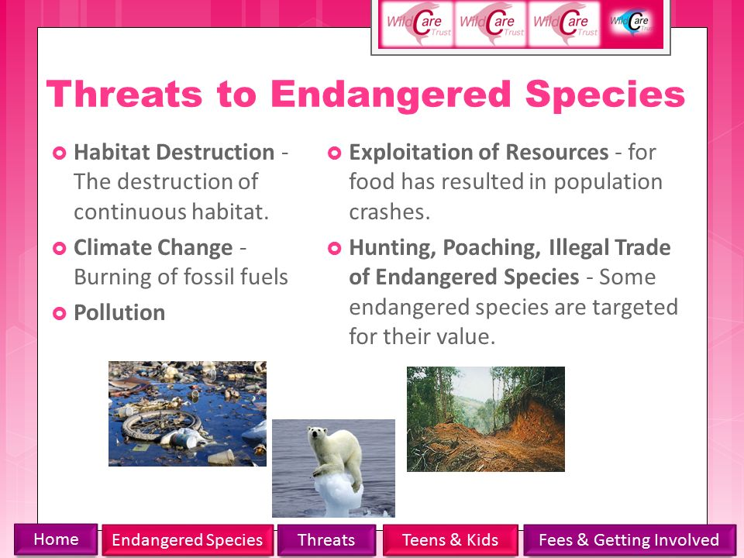

Slide 17
Therefore we should never kill animals and do the best we can to save them from the verge of extinction

Slide 18
THANK YOU

